Slide 1
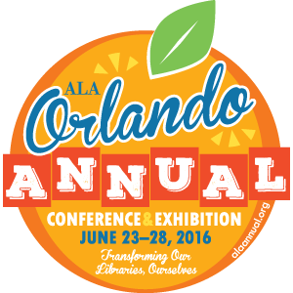
Digital Preservation Education: Choosing The Options That Are Right For You
#alctsAC16
Jacob Nadal, The Research Collections & Preservation Consortium
Jaime Schmacher, Northern Illinois University
Dr. Jane Zhang, Catholic University of America
Moderator: Emily Holmes, Columbia University
June 26, 2016
Sponsor:
PARS Executive Committee
Co-Sponsor:
ACRL Professional Development Committee

Slide 3
Think Like a Computer
Frameworks for Learning in Digital Preservation Jacob Nadal | jnadal@princeton.edu | jacobnadal.com/639

Slide 4
The Problem
Digital preservation is an electrical engineering problem.
(Or at least, it’s not not an electrical engineering problem, nor is it not a formal logic problem.)
Data are hard to come by, but…
…I have reason to suspect that computer science and electrical engineering are not the primary feeder degrees for the MLS.

Slide 5
Avoiding Head on Collision
The Outcome:
Frameworks and Applications: once a level of confidence is established, providing a (dialectical) system to support ongoing education and analysis
Three Strategies:
Digital Preservation Analogs: general preservation principles that apply to digital preservation issues
Close Readings of History: leveraging existing skills in textual analysis to understand how computing developed
Digital Preservation Games: Computing and digital preservation technology, presented as interactive activities

Slide 6
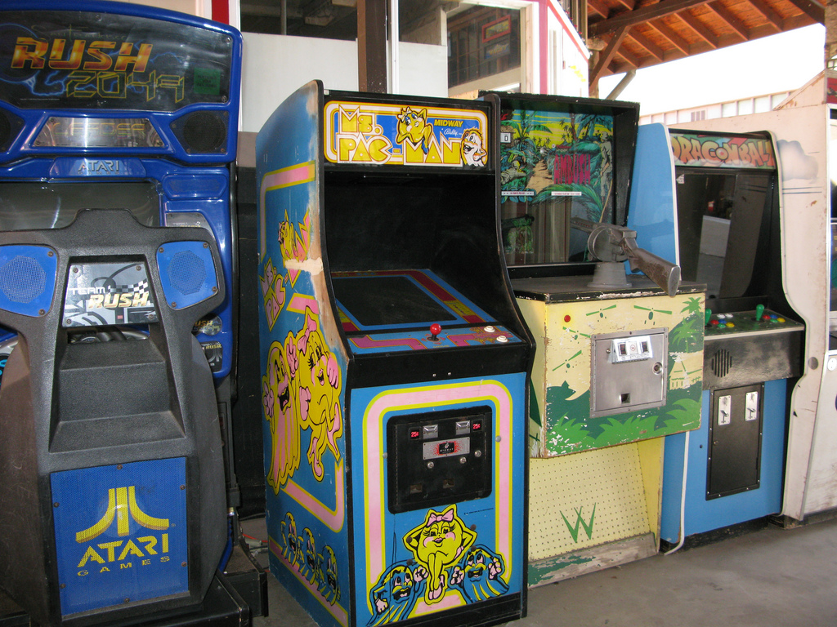
Let’s Play a game
Anti Magic Spell

Slide 7
IT WORKS JUST LIKE IT ISN’T MAGIC!
Because it isn’t.
It’s a fairly simple process, made obvious.
Everything a computer does is a fairly simple process (lots of them, quickly).
Digital preservation education makes those processes obvious (or at least, less obscure).

Slide 8
Packet Switching Network
The Game of…

Slide 9
Packet Switching Network
Each person writes their name on a card and gives the name card to the leader
Each person writes down elements from the ALCTS definition of digital preservation (next slide), labelling the cards: CM1, CM2…n; CC1…n; CI1…n, etc.
Pass cards from one person to another, at random, at a steady rate.
The leader will call a name and a part of a definition (“Chris, CC2”)
If you have the card but your name was not called, pass the card.
If your name was called start counting passes, and when you receive the card, say “got it in #” and read the definition.
Periodically, the leader may reconfigure the network, by removing people or reorganizing the placement of people.

Slide 10
Content Maintenance (CM)
A robust computing and networking infrastructure
Synchronization and storage of files at multiple sites
Continuous monitoring and management of files
Programs for refreshing, migration and emulation
Creation & testing of disaster prevention and recovery plans
Periodic review and updating of policies and procedures
Content Creation (CC)
Clear and complete technical specifications
Production of reliable master files
Sufficient descriptive, administrative and structural metadata to ensure future access
Detailed quality control of processes
Content Integrity (CI)
Documentation of all policies, strategies and procedures
Use of persistent identifiers
Recorded provenance and change history for all objects
Verification mechanisms
Attention to security requirements
Routine audits

Slide 11
LOCKSS
The Game of…

Slide 12
Game of LOCKSS
“Lots of Copies Keep Stuff Safe”
Peer-to-peer digital preservation
Lots of sites harvest data from a source and compare their copies to repair errors
If a source is lost, they supply the content

Slide 13
Rules
I will “transmit” some data to you
First, by speaking
Then, you will see some text transmissions of that data
You will “harvest” those data by listening and writing them down
You will break into groups and try to reconstruct what I transmitted

Slide 14
(Instructor Notes)
Verse with nonsense words is read (Carrol, Seuss, etc.). Meter and rhyme let you teach the idea of error-correction mechanisms.
And/or, when working with hearing-impaired students, timed slides quickly showing parts of the text, in and out of sequence, are displayed
You can also use this to play with “noise and signal” by doing multiples at once, to see how accuracy changes

Slide 15
Compression
The Game of…

Slide 16
Basics
Compression removes data from a source to reduce the size of a file
This can be lossless or lossy
Lossless compression reproduces data perfectly bit-for-bit.
Lossy compression reproduces data usably.

Slide 17
Rules
Almost the opposite of the game of LOCKSS
You get a whole, uncompressed text!
You create a shorter version by removing repeated letters, spaces, or what you will
Two groups do lossy, two do lossless
We compare strategies

Slide 18
(Instructor Notes)
Verse is ideal here again, because it is rule-bound.
Prose will certainly work, but concrete poetry should be treated with grave caution.
You should include character counts with each stanza or paragraph to help students benchmark their progress.
After the compression time, groups switch texts and decompress their classmates work.
Learning, hilarity, and occasional horror ensues.

Slide 19
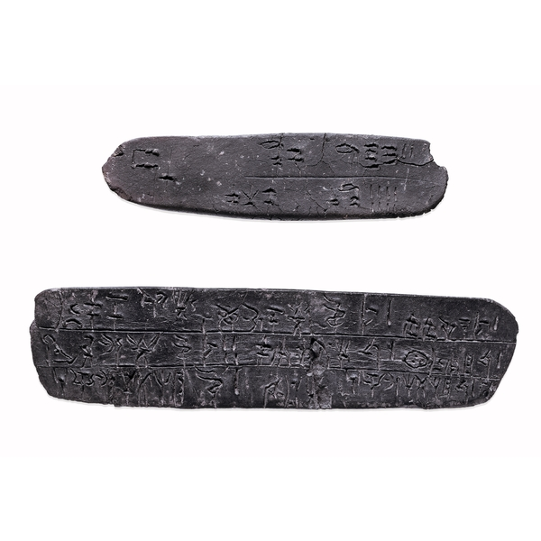
LINEAR B: Digital Preservation Analog
Photo: British Museum http://www.britishmuseum.org/

Slide 20
Linear B
Bronze Age Cretan script: c. 1450 to 1375 B.C.
Discovered by Sir Arthur Evans, spring of 1900, on numerous inscribed clay tablets.
No cribs, such as the Rosetta Stone; an almost entirely logical decipherment
“Decoding” is the essential problem that digital preservation tries to avert or mitigate

Slide 21
The Process of Decoding
Counting system was easy to determine
Analog to Digital: some formats and encodings are favored because they are easy to identify
Debate over relation to Greek or Cypriot, but most scholars believed it was a unique Cretan language.
Analog to Digital: encoding and file format
Alice Kober identifies word triplets and separates symbols into modifiers and word stems
Analog to Digital: metadata, headers, content blocks, data structures
Michael Ventris clarifies consanant-vowel patterns and problem of dropped syllables (e.g. i-n(i)-vi-si-b(i)-le)
Analog to Digital: the problem of compression
Notes:
gaps at ends of lines on right
alphabetic from 20 to 40 characters, semagramatic (e.g. Chinese) have several thousand, and syllabic between 50 to 100.

Slide 22
This is a story of digital preservation:
Began with identification of parts…
Digital Forensics and Analysis
…associated with possible informational content…
Metadata and Contextual Information
…then instantiated by a subject expert and translated into a known, contemporary language.
Digital Curation and Migration
And the subtext of this story is that preservation is a multi-party effort that plays out over time

Slide 23
Teaching digital preservation through history of Computing
Close Readings

Slide 24
Formal Classroom
Class sessions build on critical reading skills common to humanists through assigned readings in the history of computing:
The Information: a History, a Theory, a Flood. James Gleick.
Soul of a New Machine. Tracy Kidder.
Where Wizards Stay up Late. Katie Hafner.
In seminar-style class sessions:
Students interpret and retell the story, gaining agency and ownership.
Professors (or invited guests) unpack technical concepts so students encounter them as supporting elements to that narrative.
The class models the relationships that librarians must have with allied disciplines (technologists included) throughout their careers.

Slide 25
Narrative to Analysis
Re-situated this way, humanist analytic tools can be brought to bear…
The door is open to digital preservation as something enacted through frameworks…
And that’s rich terrain….
NDSA, DPOE, DPM, OAIS, TRAC, &c.

Slide 26
Media-Rendering
A Teaching Framework

Slide 27
Media-Rendering
Substrate/Ground: Tangible substance that carries media
Media/Figure: Materials that record information
Transport/Usage environment: Means(s) for perceiving media
Knowledge Base: System for interpretation of media

Slide 28
Implementing Solutions: Materials & Rendering
Substrate: material substance(s) of the object (e.g. paper, film, aluminum, silicon)
Media: the material substance(s) that record information (e.g. ink, silver, ferrous alloys, electrons)
Transport: the means of moving information from the Media to the reader (e.g. light, light, SATA bus, USB bus)
Language: the semiotic system(s) that renders the information in a meaningful way (e.g. Latin, Cinema studies, TIFF, PDF)

Slide 29
Media-Rendering
Critical for Physical Preservation
Substrate/Ground: Tangible substance that carries media
Media/Figure: Materials that record information
Transport/Usage environment: Means(s) for perceiving media
Knowledge Base: System for interpretation of media
Critical for Digital Preservation

Slide 30
THANK YOU!

Slide 31
Think Like a Computer: Frameworks for Learning in Digital Preservation Jacob Nadal | jnadal@princeton.edu | jacobnadal.com/639
Principles
Frameworks
Preservation requires Materials (Substrate; Media) and Rendering (Transport; Language).
Materials are the core challenge of physical preservation; Rendering for digital preservation.
Ask how any training will help you learn to move data around (transport) or to make data usable (language).
Computers are machines for performing binary logic operations, incidentally powered by electricity.
If you can imagine a conditional series of events, a computer can execute it.
Librarians have to describe the essential requirements and logical flow of systems.
Developers refine our requirements and make a best-SWpossible implementation at a given point in time with prevailing technology.
Computers and programming happen in history and in the real world. Over time, we gain perspective on them just like any other information artifact.W
Preservation is a sustainable process, optimized over time. What you do correctly now, will be wrong later.
ALCTS Definition of Digital Preservation: http://www.ala.org/alcts/resources/preserv/defdigpres0408
OAIS: http://public.ccsds.org/publications/RefModel.aspx
TDR/TRAC: https://www.crl.edu/archiving-preservation/ digital-archives/metrics-assessing-and-certifying/trac
DPOE: http://www.digitalpreservation.gov/education/
NDSA: http://ndsa.org/
DPM “Three legged stool”: http://www.dpworkshop.org/
PREMIS: http://www.loc.gov/standards/premis/
Frameworks help you decide what you need to learn next and if a particular tool or system meets your needs.
Frameworks let you learn parts of a whole, and let you evaluate individual tools as part of a system.
Principles help you understand if new frameworks are viable and if new tools ones can be effective.

